Slide 1

Retail Relay
Homework II
Group E
Donald Beckworth
Jack Harris
Russell Maben
Michael Morales

Slide 2


Methodology
Preliminary analysis was a basic logistic regression using XcelStat. Data was then processed in R Studio using various methods, and Azure ML using a boosted decision tree.
Missing values were not included in the analyses in R Studio.
Columns Added: Time as Customer = Date Last Order minus Date First Order
Vectorized City, Day, and Month
Log Values of measure fields

Slide 3

Initial Analysis
Train dataset includes 24,546 observations with 28 variables.
Test dataset includes 6,208 observations with 28 variables.
Initial Train dataset distribution by city:
Baltimore - 1,365
Charlottesville - 7,001
DC - 6,954
Richmond - 9,226

Slide 4

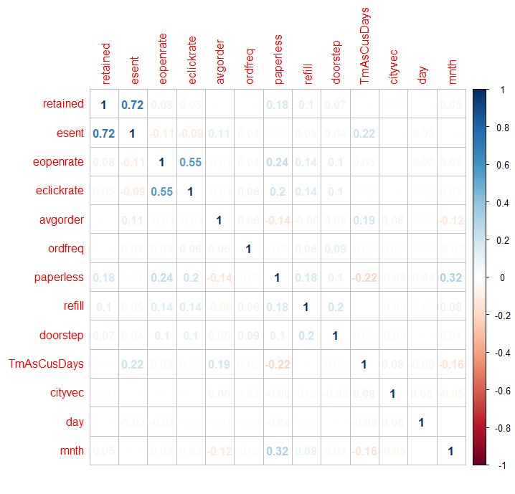
Correlation of Values

Slide 5
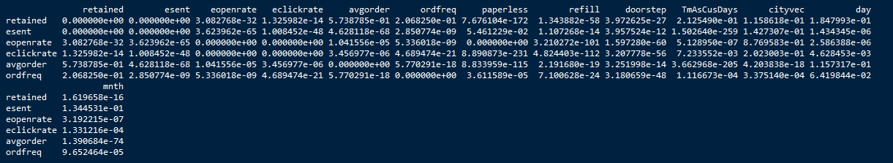
P-values of correlations

Slide 6

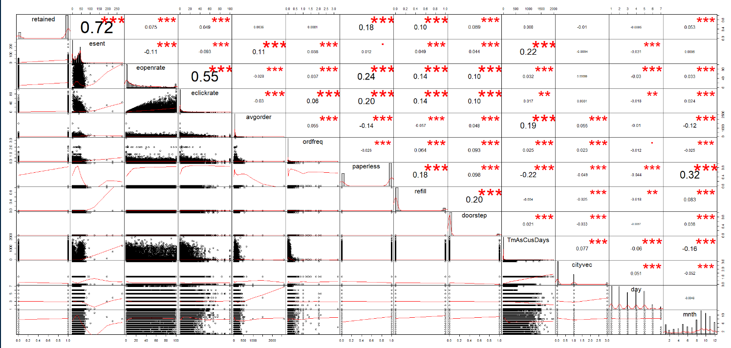
Variable Relationships

Slide 7
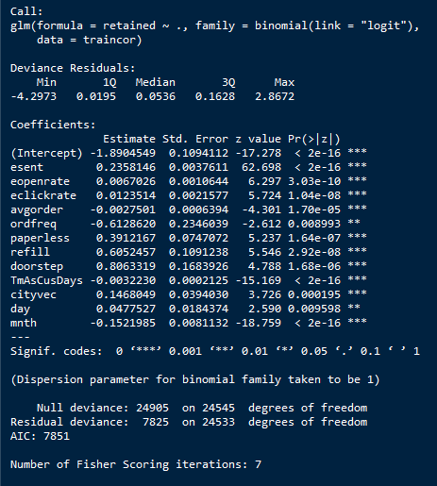
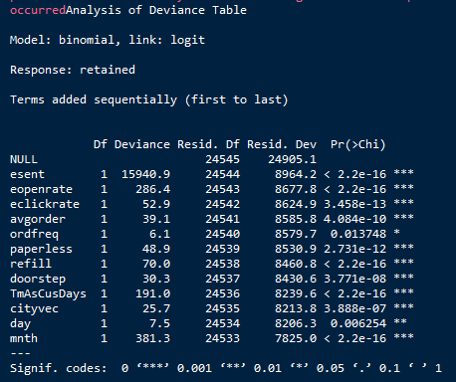
Logistic Model #1
Includes all variables

Slide 8
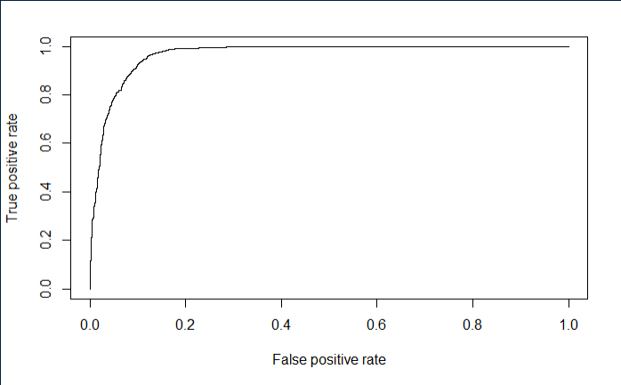
Logistic Model #1 False Positive Rate

Slide 9
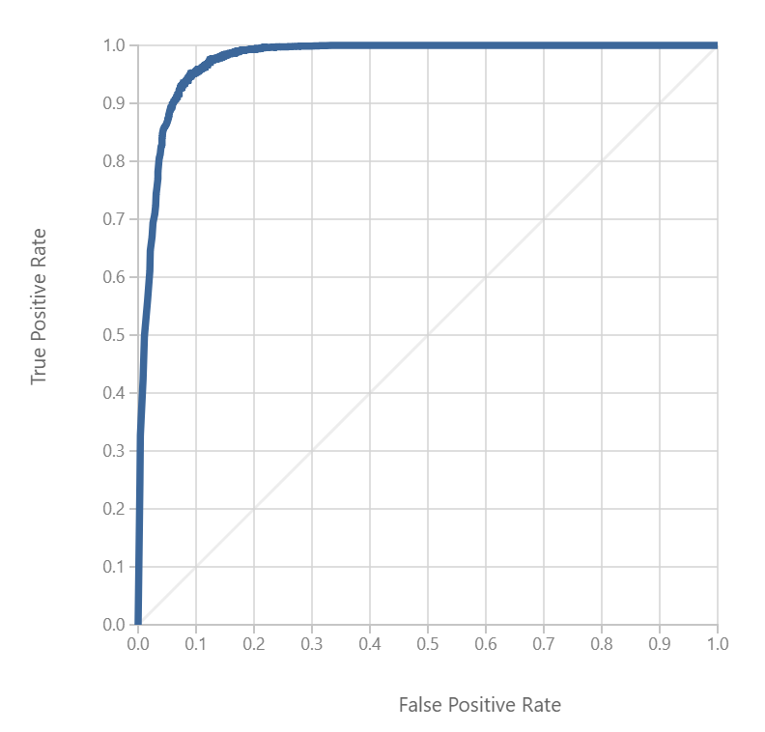
Azure ML Model False Positive Rate

Slide 10

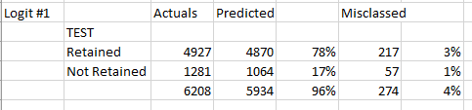
Logistic Model #1 Hit Rate
Other models with variables removed returned results that were less than desirable.

Slide 11
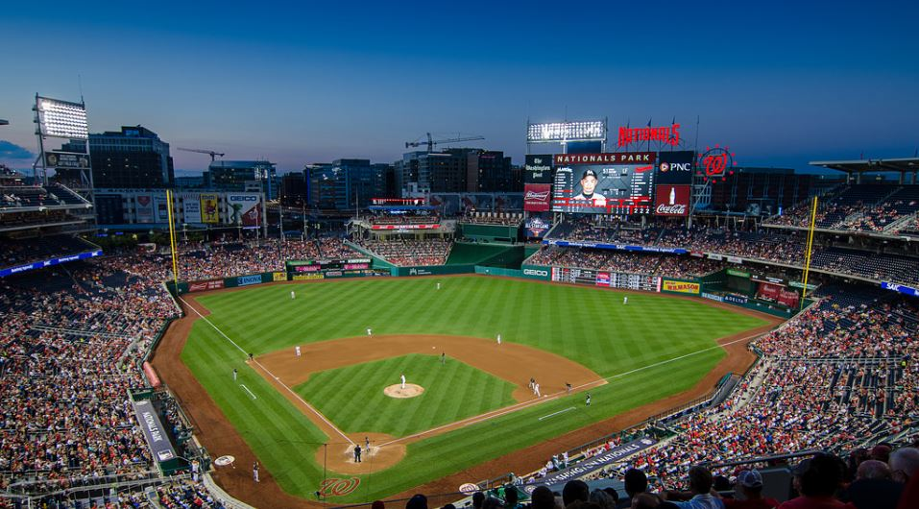
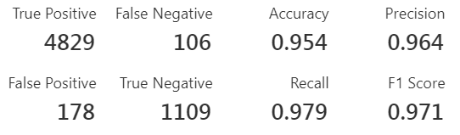
Azure ML Model Hit Rate
Notes:
The Azure ML model was a boosted decision tree, which is ideal for binomials.

Slide 12
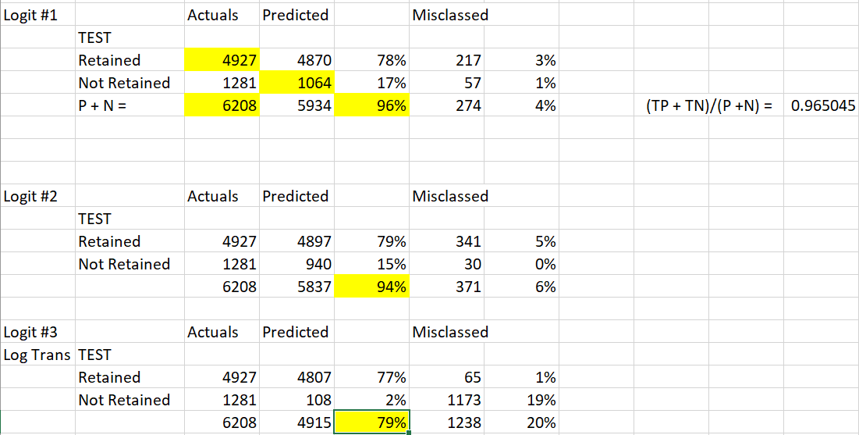
Comparison of models
Notes:
Accuracy was calculated using the (TP + TN)/(P + N) formula. The best hit rate came from the first model, which included all variables. No other iterations produced results with better accuracy.

Slide 13

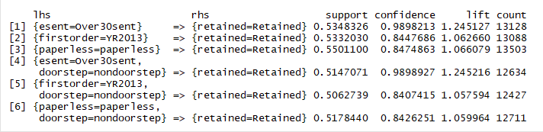
Rules Mining
The apriori function in R Studio calculates association rules once the data have been placed into “bins” of various sizes, i.e. >30 emails sent, year of first order, etc.
Notes:
Rules mining provided insight into what makes a loyal customer. The results seem to suggest that the customers with the most history are most likely to be retained. There is a strong correlation between retained and >30 emails sent, which is a potential indicator of clients with history, or may suggest that Relay is good at the timing of their email marketing.

Slide 14
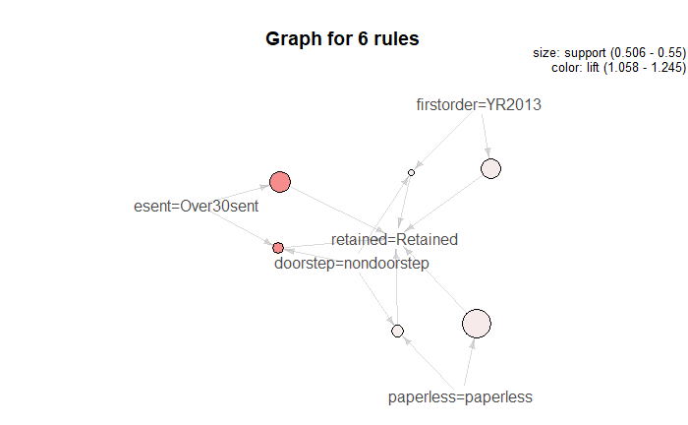
Graph for Six Rules

Slide 15
Conclusions
The R Studio and Azure ML models resulted in similar accuracy rates, which suggests that they will predict retention well. Discretization and rules mining variables such as esent, eclickrate, and eopenrate resulted in six rules with high lift and confidence. These rules provide a clearer picture of what makes a loyal customer. As suggested in the book, a subscription program may be the key to retention since the customers with the longest history seem to be the most likely to be retained.

